Slide 1


PREDICT INCOME LEVELS
TEAM MEMBERS:
Priyaanka Reddy Boothkuri – U70184580
Niharika Mullangi – U57336324
Manogna Tummanepally – U39202669
Pranathi Cheemarla – U22927056
Santhoshini Bojanapally – U88362375

Slide 2





INTRODUCTION
Problem Statement
In order to improve marketing and sales strategies, retail company wishes to create a data-driven segmentation strategy based on income categories. This project aims to identify and target specific customer segments effectively.
Challenges
Economic Downturns
Competition

Slide 3




POTENTIAL BUSINESS OPPORTUNITIES
01
To reevaluate the current customer and plan the strategy to overcome the impact.
02
To make better business decisions.
03
Inventory management to optimize the supply chain.

Slide 4

DATA OVERVIEW
The UCI Adult dataset, also referred to as “Census-Income” dataset is sourced from the 1994 United States Census data.
Number of records – 48,842
Data Attributes - The dataset contains 14 variables(features) for each record, including both categorical and continuous features.
TARGET -
Income: The binary target variable indicating whether the individual earns more than $50,000 annually (which according to the US Bureau of Statistics accounts for $104,000 annually in 2023) or not.

Slide 5
DATA OVERVIEW
FEATURES -
Age: The age of the individual.
Work-class: The type of employment (Private, Local-gov, etc.,).
Education: The highest level of education of an individual.
Education-Num: Number of years of education an individual received.
Marital Status: The marital status of the individual.
Occupation: The type of occupation an individual is engaged in.
Relationship: The individual’s relationship status (Husband, Wife, Daughter etc.,).
Race: The individual’s race (White, Asian-Pan-Islander etc.,).
Sex: The gender of the individual.
Capital Gain: Capital gains reported by the individual.
Capital Loss: Capital losses reported by the individual.
Hours Per Week: The number of hours worked per week.
Native Country: The birth country of the individual.

Slide 6
DATA PREPROCESSING
Drop unnecessary columns : RELATIONSHIP, EDUCATION_NUM, FNLWGT , NATIVE_COUNTRY, OCCUPATION
Handling missing values : WORK_CLASS
Encoding categorical features : WORKCLASS, EDUCATION, MARITAL_STATUS, RACE and SEX
Scaling or normalizing numerical features : AGE, CAPITAL_GAIN , CAPITAL_LOSS , HOURS_PER_WEEK

Slide 7
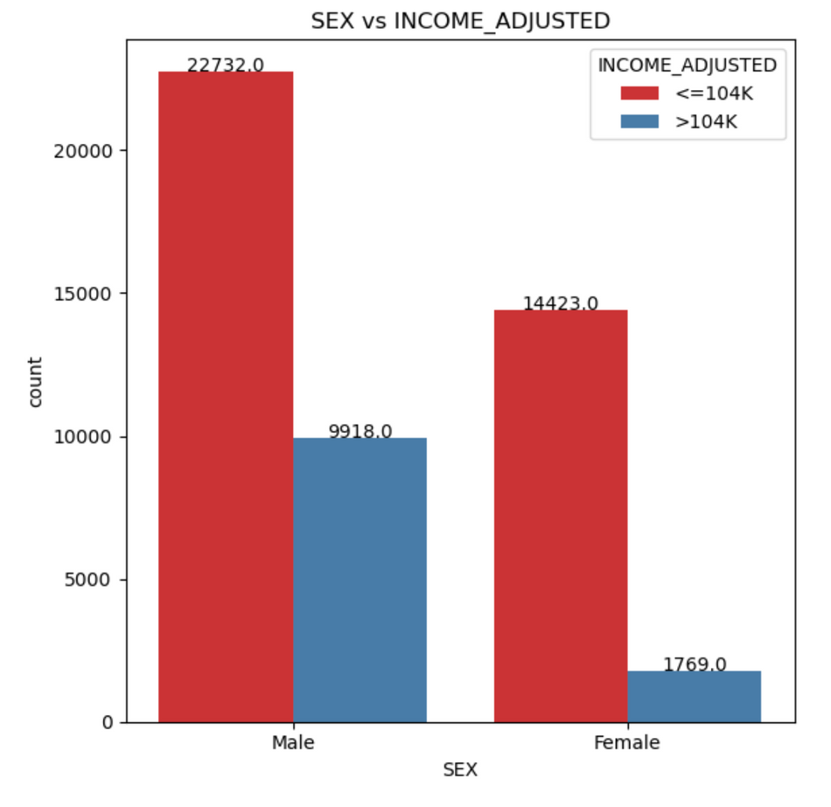
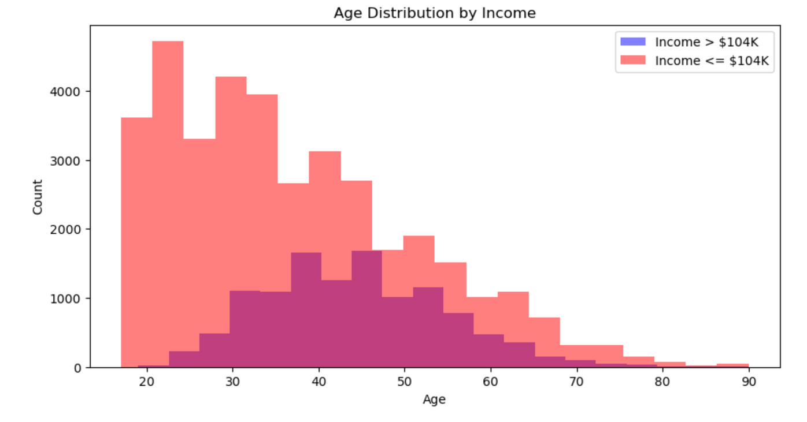

Slide 8


PROCESS
Step 1
Step 2
Step 3
Step 4
Load the dataset
Data Pre-processing
Split the dataset
Balancing the data
Step 5
Step 6
Step 7
Standardization
Model Selection and Fitting
Hyperparameter Tuning

Slide 9

MODEL SELECTION
Logistic Regression
Random Forest
Support Vector Machines
XG Boost

Slide 10
PERFORMANCE INDICATORS
Represent instances where the model correctly identifies high-income individuals, enabling businesses to effectively target luxury brands to them
True Positive
Correspond to cases where the model accurately identifies low-income individuals, facilitating the targeting of budget-conscious consumers by discount stores.
True Negative
Represent instances where the model incorrectly classifies low-income individuals as high-income, potentially leading to misdirected marketing efforts.
False Positive
Occur when the model wrongly categorizes high-income individuals as low-income, potentially missing out on revenue opportunities.
False Negative

Slide 11

RESULT
 | Accuracy | Precision | Recall | F1 - Score | ROU-AUC
Logistic Regression | 82.1 | 60.36 | 75.03 | 66.91 | 89.04
Random Forest | 82.79 | 60.83 | 80.36 | 69.24 | 90.66
XGBoost | 79.30 | 54.57 | 84.46 | 66.30 | 90.02

Slide 12
CONCLUSION
Random Forest appears to be the best-performing model in terms of Recall (80.36%), indicating its ability to effectively identify high-income and low-income customer segments.
While Logistic Regression and XGBoost also show respectable Recall scores, Random Forest seems to be the most suitable choice for this specific business scenario, as it balances Recall with other metrics, such as Precision, reasonably well.
In summary, the retail company should consider adopting the Random Forest model to create an effective data-driven segmentation strategy based on income categories, with a focus on optimizing Recall. This should lead to more accurate targeting of high-income and low-income customer segments, ultimately improving marketing and sales strategies and potentially boosting revenue.

Slide 13


